Slide 1

UZA-mifugo
Business model canvas

Slide 2


Slide 3
Project team members
1. Kitauka Innocent
2. Sijali Madikah
3. Nkeshimana Carmel
4. Japheth Mumo

Slide 4
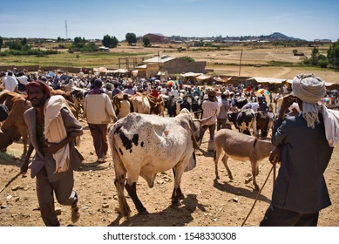
Description of the business
We are building a Mobile App and a website where local Wananchi can sell livestock from their distributed areas with ease and convenience.

Slide 5
…
People from remote areas travel to nearby markets to sell their livestock.
Sometimes the seller gets the buyer, while other times an entire day can pass with no buyer found.
This app will thus be registered under various market councils under which sellers will be able to present what they intend to sell against their quoted prices, allowing sellers to easily identify them and place an order.

Slide 6
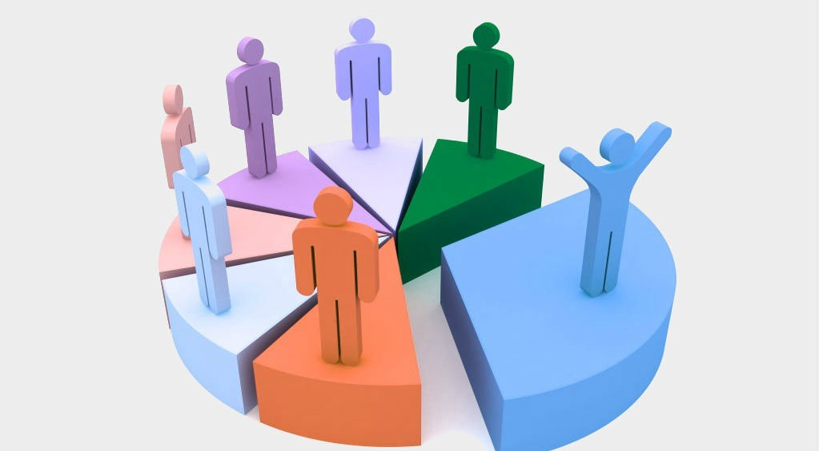
Customer segments
Local Wananchi
Livestock farmers
Butchers
Meat Industries – Arusha Meat
Pastoralists
Food Brands – Nestle, Unilever
Dairy Companies

Slide 7
Value PROPOSITION
Improved linkage between buyers and sellers from remote areas
Detailed information of product prior to buying assisting in decision making.
It prevents middlemen (blockers) from exploiting buyers and sellers.
Convenience
High performance
Cost Reduction

Slide 8
Channels
We will contact customers through the registered Market Councils e.g. Arusha Meat.
Promotion of our app via local radio stations
Advertisement via weekly social gatherings
Social Media
Website
Word of Mouth

Slide 9

Customer relationships
Connect customers through social media, adverts, word of mouth etc.
Keeping customers records.
Daily detailed updates i.e. New products

Slide 10
KEY ACTIVITIES
Excellent network to accessing customers
Advertisement
Marketing

Slide 11

KEY RESOURCES
Finance resources
Human resources
Intellectual Property rights

Slide 12

KEY PARTNERS
Payment Providers – Mpesa, Tigo Pesa, Halotel Money
Government
Pastoralists
Meat Processing companies – Afri Meat, Arusha Meat, Arusha Sausage, Various butcheries

Slide 13
COST STRUCTURE
Expenses from government levies
Content designers
Platform Cost – (hosting, upgrades)

Slide 14

REVENUE STREAMS
Subscription fee for sellers
Commission fees on sales

Slide 15
THE END

